Slide 1

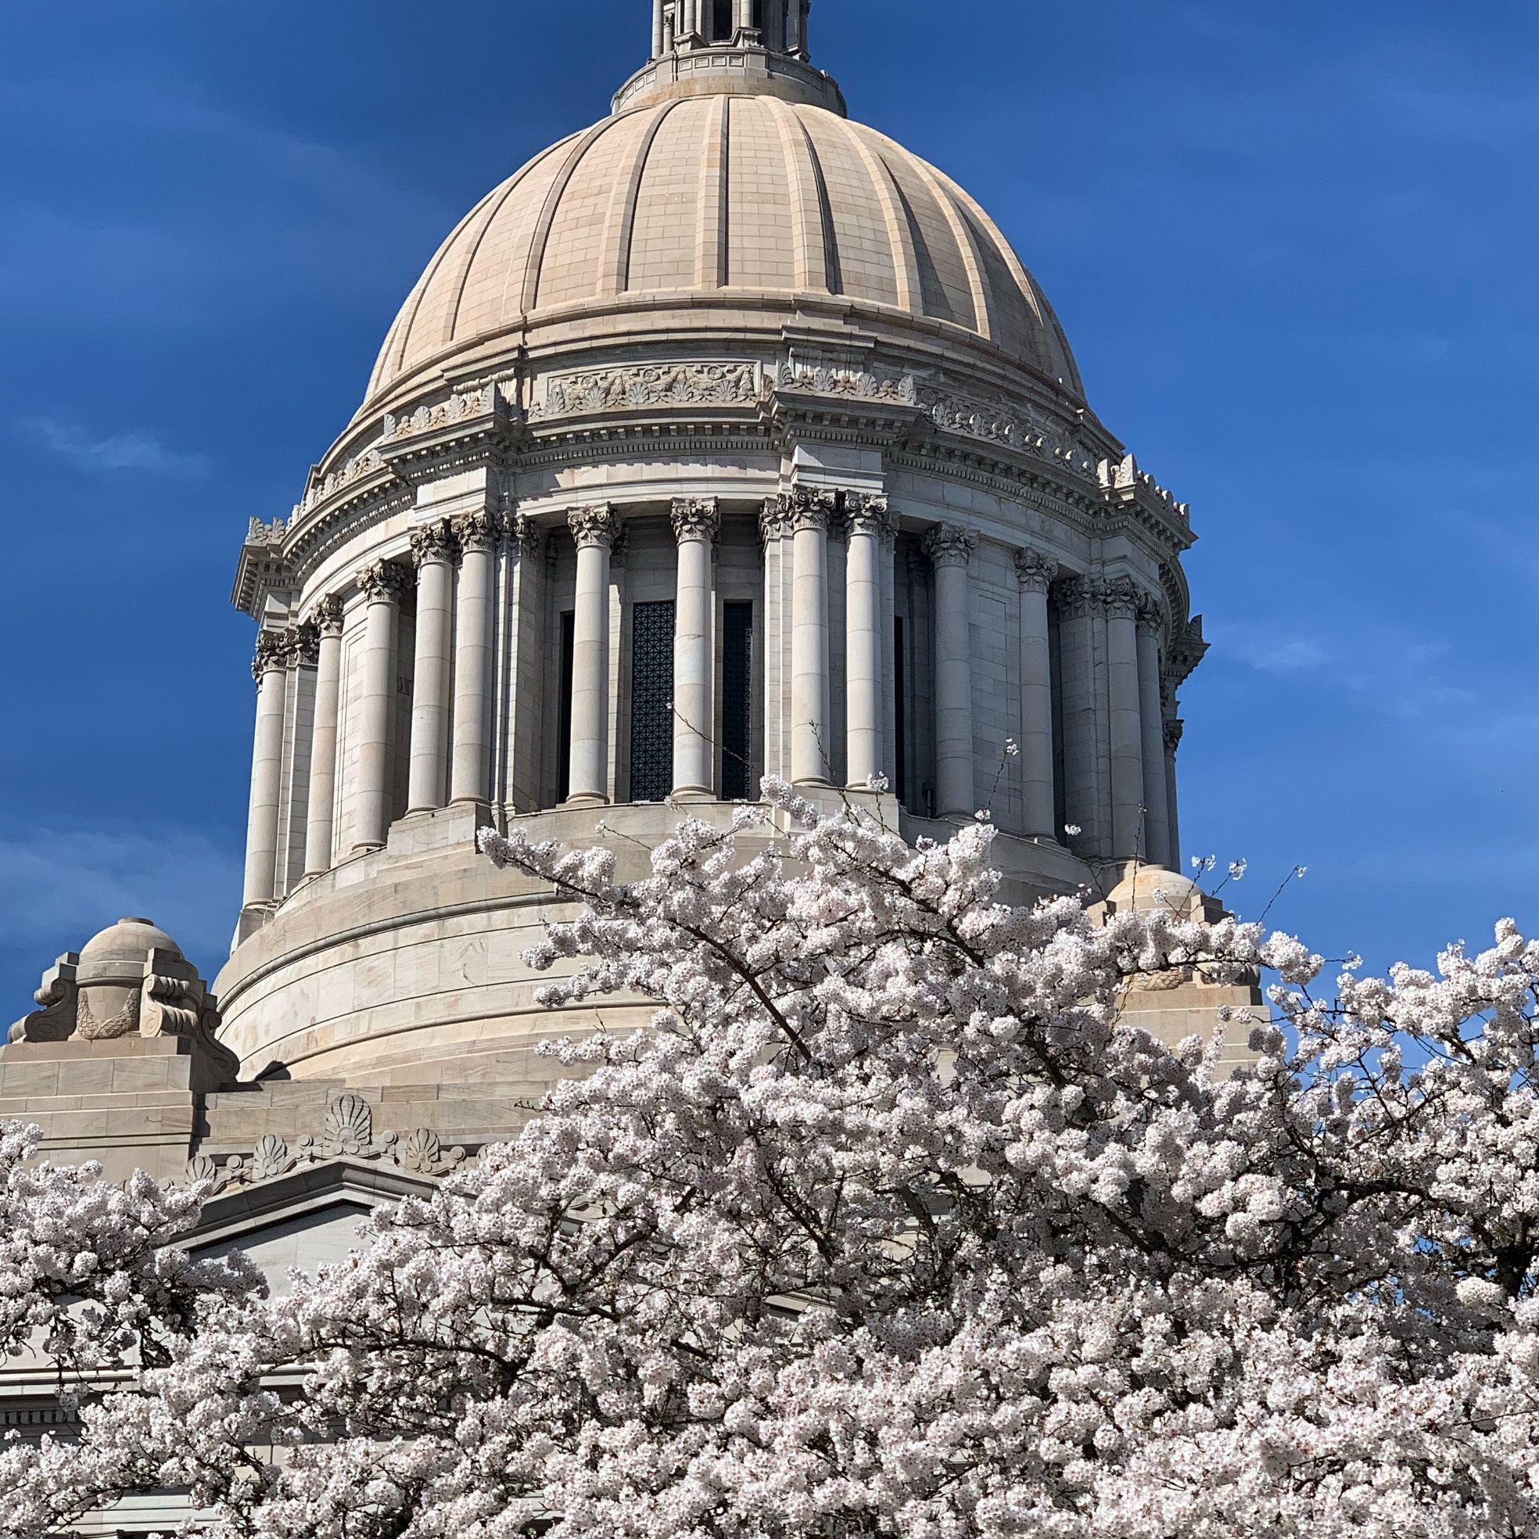

WACD:
Advocacy &
Legislative Outreach
Brynn Brady, Ceiba Consulting, Inc.

Slide 2
Legislative Primer
Two Chambers: House & Senate. The Senate and House of Representatives meet in session each year to create new laws, change existing laws, and enact budgets for the State
49 Legislative Districts. Each District has one Senator and two Representatives. In even years, every member of the House is up for re-election (two-year terms) and the half the Senate (4-year terms)
Legislative cycle is two years (Biennium): Even years are “long” (105 days) & odd years are “short” (60 days)
Long sessions (2021) begin biennium and are used to pass policy and enact the state’s biennial budgets: Operating, Capital and Transportation.
Short sessions were traditionally used to correct and respond to emergent matters, but that has changed significantly over the past 15 years.
Notes:
The Washington State Legislature is made up of two houses (or chambers), the Senate and the House of Representatives. Washington has 49 legislative districts, each of which elects a Senator and two Representatives. Senators serve four-year terms and Representatives serve two-year terms. The Senate and House of Representatives meet in session each year to create new laws, change existing laws, and enact budgets for the State.
The legislative cycle is two years long. Within that two-year cycle, there are two kinds of legislative sessions: regular sessions and extraordinary, or special, sessions. Regular sessions are mandated by the State Constitution and begin the second Monday in January each year. In the odd-numbered year, for example, 2005, the regular session is 105 days; in the even-numbered year, for example, 2006, it is 60 days. Extraordinary sessions are called by the Governor to address specific issues, usually the budget. There can be any number of extraordinary sessions within the two-year cycle, and they can last no more than 30 days. To see the legislative calendar for the most recent session, go to the Cut-off Calendar on the Agendas, Schedules, and Calendars page.
The members of the House and Senate offer legislation, or bills, for consideration. The ideas for bills come from a number of places: something has happened in the last year that inspires new legislation (for instance, the change in people's perception of crime gave rise to the youth violence bills that were offered during the 1994 Session), a member wishes to address an issue that is specific to his or her district, the Legislature decides to tackle a major issue (such as regulatory reform), changes in technology dictate a change in the State's laws, etc.
Once a member introduces a bill, the legislative process begins. The process has a number of specific steps. If the bill makes it through all the steps in the chamber in which it was introduced (the "first house"), it goes to the other chamber (or "second house") and goes through the same steps there. Each step is identified and explained below.
Prefiling: Members can prefile bills for introduction in the month before session begins. Prefiled bills are officially introduced the first day of the session.
Introduction, or First Reading: The first thing that happens to bills on the "floor" is introduction and referral to committee. This is also referred to as the bill's first reading. (Bills must have three readings in each house in order to pass the Legislature.)
Leadership determines to which committees bills will be referred; this is usually determined by the bill's subject matter. Bills that require an appropriation or that raise revenue must also go to a fiscal committee for review.
To see which bills will be introduced for the upcoming legislative day, go to the Agendas, Schedules, and Calendars page and display House Introductions or Senate Introductions.
Committee Action: The chair of each committee works with leadership and staff to schedule bills to be heard by the committee. Committees hold three kinds of meetings: (1) work sessions, where issues are determined and reviewed; (2) public hearings, where testimony from interested parties is taken; and (3) executive sessions, where the committee decides how it will report the bill to the whole house. Not all bills get scheduled for hearing, so a good number of bills never get any further than committee.
Bills can be reported in several fashions, the most usual being do pass (pass the bill just as it is), do pass as amended (pass the bill as amended by the committee), and do pass substitute (the committee offers a different version to take the place of the original bill). The members on the prevailing side sign the "majority" report; those members who disagree with the majority sign the "minority" report. Not all bills coming out of committee have minority reports. To see a list of bills reported out of House or Senate committee each day, go to Standing Committee Reports.
As a bill moves through the committee process, the staff prepares the "bill report." The bill report includes a legislative history of the bill, background on the issue, a summary of the legislation, the names of those who testified on the bill, and a summary of the testimony for and against the bill. The bill report is edited as the bill moves through the process. When the bill moves to the opposite house, that house prepares a bill report as well. A bill that has finally passed the Legislature would have House, Senate, and Final bill reports.
At the start of the session, both houses agree on dates by which bills have to be reported out of committee in order to be eligible for further consideration by the Legislature. There is a "cut-off" date for bills to be out of committee in the first house and one for bills to be out of committee in the second house.
Rules Committee: Once a bill has been reported by the appropriate committee(s), the floor acts on the committee report and then passes the bill to the Rules Committee. Usually, the floor adopts the committee's recommendation.
The Rules Committee is where leadership exercises the most control over the process. The Rules Committee is made up of members from both parties. Each member on the committee gets to select two or three bills that will move on to the next step in the process. Which bills a member selects could be the result of a party caucus, or another member approaching that member, or a piece of legislation about which the member feels strongly.
Rules Review /Rules White: The first step in the Rules Committee process is called Rules Review in the House and Rules White in the Senate (the report that lists the bills in this step in the Senate is printed on white paper). Rules Committee members review the bills and decide whether or not to move them on to the next step.
Rules Consideration /Rules Green: The next step is called Rules Consideration in the House and Rules Green in the Senate (the report is printed on green paper). Sometimes bills skip this step and go to the calendar for second reading. It is another step that allows leadership to control the process.
Calendars/Bill Report Books: The Rules Committee decides which bills will be scheduled for second reading. Those bills that will probably require some debate are placed on the regular calendar. Those that are probably not controversial may be placed on the suspension calendar in the House, the consent calendar in the Senate. The Rules Committee also decides whether a bill will be placed on the regular calendar or the suspension/consent calendar.
Each house prepares documents that list the bills scheduled to be heard on the floor. The House prepares "bill report books" (containing an order of contents and the bill report of each bill on the calendar) and "floor calendars" (a list of the bills, a brief description for each, and the committee action on each). The Senate prepares "calendars" (with an order of contents and the bill report of each bill), and "flash calendars" (the list with the brief descriptions and committee actions). The Senate flash calendar lists only those bills that were "pulled" from Rules at the last Rules Committee meeting. To see which bills are on the calendar in either house, go to House Floor Activity Report or Senate Floor Activity Report.
Second Reading: It is on second reading that the chamber discusses the merits of the legislation. It is here, too, where members can offer amendments to the bill. Most bills that get this far get their second reading in the couple of weeks following the committee cut-off.
If a bill has been amended in committee or on the floor in the first house, it is ordered engrossed. Engrossing a bill means incorporating the amendments into the body of the bill so that the second house gets one document. If a bill has been amended in the second house, it is returned to the first house with the amendments attached so that the first house can decide whether or not it wishes to agree with the changes the second house made.
Third Reading: Third reading is where the roll call vote on final passage is taken. If the bill finally passes, it continues in the process. If the bill fails on final passage, it goes no further. Under certain circumstances, the chamber may decide to reconsider the vote that was taken; in that case, the chamber has twenty-four hours to make a motion to reconsider the bill.
If the bill passes third reading in the second house and the second house did not amend the bill, the bill has passed the Legislature.
At the start of the session, both houses agree on "cut-off" dates by which bills have to be finally passed out of the first house and finally passed out of the second house.
Concurrence, Dispute, and Conference Committees: If the bill has been amended by the second house, the first house has to decide whether it will concur in the amendments or not. Leadership decides which bills returned from the second house will be discussed and places those bills on the concurrence calendar (House) or concurring calendar (Senate). If the first house concurs in the amendments, the bill has passed the Legislature.
If the first house disagrees with the second house, it can ask the second house to recede from the amendments. If the second house recedes, the bill has passed the Legislature.
If the two houses cannot resolve their differences, one of them can ask for a conference committee. Members from each house meet to discuss the differences. If they agree on what is to be done, the conference committee makes a report. Both houses must adopt the conference committee report for the bill to pass the Legislature. If one house does not adopt the conference committee report (whether by vote or inaction), the bill has not passed. The House Floor Activity Report and the Senate Floor Activity Report list the bills on the concurrence, dispute, and conference calendars.
Enrolling: Once a bill has finally passed the Legislature, it is enrolled. A certificate proclaiming that it has passed is attached and, if necessary, the amendments from the second house or conference committee are incorporated into the body of the bill. The bill is signed by the Speaker of the House, the Chief Clerk of the House, the President of the Senate, and the Secretary of the Senate and is sent to the Governor for his or her action.
Governor's actions: The Governor reviews the bill. The Governor may decide to sign it, veto part of it, or veto all of it. If the Governor vetoes part or all of it, the Legislature may vote to override the veto. (That happens rarely.) If the governor does not act on a bill after the allotted number of days, it is as if it was signed. From the Governor's desk, bills go to the Secretary of State who assigns a session law chapter number. The Chapter to Bill Table (available on the Bill/Law Cross Reference page) lists the bills that have passed the Legislature, the chapter numbers assigned by the Secretary of State, vetoes, short descriptions, and the effective dates.
Carryover: The Legislature works within the framework of a two-year cycle. For instance, the 2005-06 Session is the 59th Session of the Legislature. There will be a least two regular sessions, a "long" session in 2005 (105 days) and a "short" session in 2006 (60 days). There could also be any number of special sessions, none of which can last longer than 30 days.
Therefore, just because a bill did not make it all the way through during the regular session in the odd-numbered year (for example, 2005) does not mean it is "dead." At the end of the session, all bills in the second house are returned to the first house; so a House bill in committee in the Senate when session ends is returned to the House. At the start of the next session, be it a special session or the next regular session, bills from the previous session are reintroduced and retained in their present position.
"Carryover" bills can be taken up again in subsequent sessions during the biennium. The Legislature has a lot of latitude with these bills. The first house can place the bill on the calendar for third reading and send it right back to the second house, or it can make the bill go to committee and through the whole process again.
This is in addition to the new bills introduced during the current session. This procedure can make it difficult to keep track of bills during a special session or the second regular session. If a bill does not make it through the process by the end of the two-year cycle, it is "dead."

Slide 3

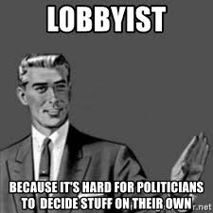



In 2020, the WA State Legislature considered 2,233 bill introductions.
Only 389 became law.
Notes:
Perspective for managing expectations. A virtual session will warrant legislators to make decisions differently. Relationships are more critical than ever!
Compare to 2019 (long session) 2,211 bills introduced and 469 became law.
The realities of conducting legislative session during the COVID-19 pandemic will substantially limit the volume of bills that can be taken up in committee and on the House floor. Process changes will increase the time to conduct business and will increase workload on staff. Budget challenges will also constrain what is possible in a tangible way.
Members are asked to limit bill introductions to no more than 7, and committee chairs will be asked to reduce the number of bills heard and passed out of their committee. We recognize that each member has individual authority and responsibility for developing their legislative agenda, but we will need to hold each other accountable to these limits in order to focus our work on the critical needs of our state and to avoid untenable workloads for our legislative staff.
First and foremost, bills should only be introduced if they urgently needed and important to pass DURING the 2021 session. If that is not the case, please wait to introduce your bill until next year.
Track all the policy and budget process. Advocate on behalf of clients in both areas. Interim used to build strengthen relationships.. Covid has changed that.
Lobbying is the act of attempting to influence decisions made by officials in the government, most often legislators or members of regulatory agencies. Lobbying is done by many different types of people and organized groups, including individuals in the private sector corporations fellow legislators or government officials, or advocacy groups/interest groups.
https://www.youtube.com/watch?v=Df32RijORLo (Thank you for Smoking)
https://www.youtube.com/watch?v=tyeJ55o3El0 (I’m just a Bill)
Pay attention to both majority and minority parties. Avoid partisanship
Lobbyists provide in a way a system of Checks and balances. Extremely difficult to read and grasp all the legislation that gets introduced. Lobbyists focus on building trusting relationships with lawmakers so when they share information, the decision maker knows what they are hearing is true and credible.

Slide 4
WA State Budgets
Operating- Pays for day to day operational expenses of state. Revenue sources include tax revenues, dedicated tax and fee revenues, federal funds and miscellaneous (earned interest and lottery receipts)
Capital- pays for major building, renovation and land acquisition projects. Primarily funded by general obligation bonds.
Transportation- Pays for transportation operating and capital costs, such as maintaining, preserving, and improving the highway system; operating ferries; motor vehicle registration; and enforcing traffic laws on the state highway system. Primary sources of are gas taxes; federal funds; vehicle license, permits, and fees; bonds; ferry & toll revenue; balances from previous biennium and other sources.
Notes:
This year is 3 biennia: 2021 Supplemental, 21-23 biennial and 23-25 four year balance budget
Each Chamber develops their own budgets and release them for public comment mid session. Budget leaders work behind the scenes to reconcile the differences. When deals are made and agreement is achieved, typically the last few days of session, the budgets are considered and passed by the full legislature. The Governor has the ability to line item veto items in these bills.

Slide 5
2021-23 Operating Budget Landscape-
3 Rs: Reductions-Reserves-Revenue
2019-21 Op Supp. Budget: $53.4B (approx. 14% more than 2017-19)
Governor vetoed 147 items, $235M reduction for 2020 and $210M in 21-23
OFM directed state agencies to prepare 15% reductions for the remaining 2020 fiscal year and continue to plan for budget savings in preparation of the 2021-23 decision packages.
Governor freezes pay raises and requires state employee furloughs
Projected shortfall is approximately $4B through 2023
Notes:
However, within days of the operating budget proposals passing each chamber, the budget and
political landscape in Washington quickly changed because of the coronavirus (COVID-19)
pandemic. In the final two weeks of the legislative session, Washington became a hot zone for
the pandemic with the number of confirmed cases and deaths increasing significantly each day,
social distancing measures went into place, and businesses and consumer spending started to
plummet. The two chambers of the legislature worked to produce and pass a budget that
walked back both chambers original proposed spending levels. However, in the days and weeks
following the adjournment of the 2020 legislative session, it quickly became apparent that the
walked-back version was not sufficient for the economic cliff the state and country had
encountered. It was in this quickly deteriorating economic landscape that Governor Inslee took
action and vetoed 147 separate items in the budget totaling $235 million in reduced spending
in the 2020 supplemental budget and $210 million in the 2021-23 biennium. The vetoed items
ranged broadly by issue and agency.
Near General Fund State (NGF-S) revenue is forecasted to decrease
by $4.5 billion in the current 2019-21 biennium and $4.3 billion in the 2021-23 biennium (see
Table 1 for detail). In looking at these numbers, it is very important to note that there is only
one year left in the current biennium. Therefore, while the numbers may look similar in size
over the two biennia ($4.5 billion and $4.3 billion respectively), the shortfall in revenue in the
current biennium will have a much greater impact given there is just one year in which to
address that revenue loss compared to the full 2021-23 biennium.

Slide 6
2021-23 Budget Landscape-
3 Rs: Reductions-Reserves-Revenue
Reserves/Reversions
  Budget Stabilization Account $2B
  Reversions: caseloads, other savings $570M (vs.$187M)
Revenue is less than February 2020 but not as low as June 2020 ($380M)
Federal support was $4.2B in unanticipated receipts (CARES, FEMA)
Unknown factors: additional federal support, future economic forecasts, state emergency funding needs, policy level investments, other resources (new revenue ideas, fund transfers)
Notes:
BSA used only $200M for covid in 2020
U.S. employment increased by 638,000 jobs in October; the unemployment rate declined to 6.9%.
• U.S. real GDP increased at an annual rate of 33.1% in the third quarter of 2020 but remains 2.3% below pre-pandemic GDP.
• U.S. residential construction activity is well above year-ago levels.
• Washington housing construction improved to 43,700 units (SAAR) in the third quarter from 40,300 units in the second quarter.
• Seattle-area consumer price inflation exceeded the national average in October.
• Major General Fund-State (GF-S) revenue collections 14 % higher than September forecast. for the October 11 - November 10, 2020 collection period came in $247.8 million (14.0%) higher than the September forecast.
• Cumulatively, collections are now $380.3 million (11.5%) higher than forecasted.

Slide 7
2021-23 Transportation and Capital
Budget Landscape
TRANSPORTATION
Will be a challenge
Can’t maintain existing assets
I-976 and multi-modal account
Culvert injunction
Without new money, projects will be delayed, cut or stopped
CAPITAL
Invest in shovel ready projects (jobs) statewide
2019-21 authorized $3.2 B in projects
2021-23 estimated bond capacity is $3.3B
Bond capacity related to operating budget
Proposal to adjust bond capacity for capital investments
Notes:
BSA used only $200M for covid in 2020
U.S. employment increased by 638,000 jobs in October; the unemployment rate declined to 6.9%.
• U.S. real GDP increased at an annual rate of 33.1% in the third quarter of 2020 but remains 2.3% below pre-pandemic GDP.
• U.S. residential construction activity is well above year-ago levels.
• Washington housing construction improved to 43,700 units (SAAR) in the third quarter from 40,300 units in the second quarter.
• Seattle-area consumer price inflation exceeded the national average in October.
• Major General Fund-State (GF-S) revenue collections 14 % higher than September forecast. for the October 11 - November 10, 2020 collection period came in $247.8 million (14.0%) higher than the September forecast.
• Cumulatively, collections are now $380.3 million (11.5%) higher than forecasted.

Slide 8
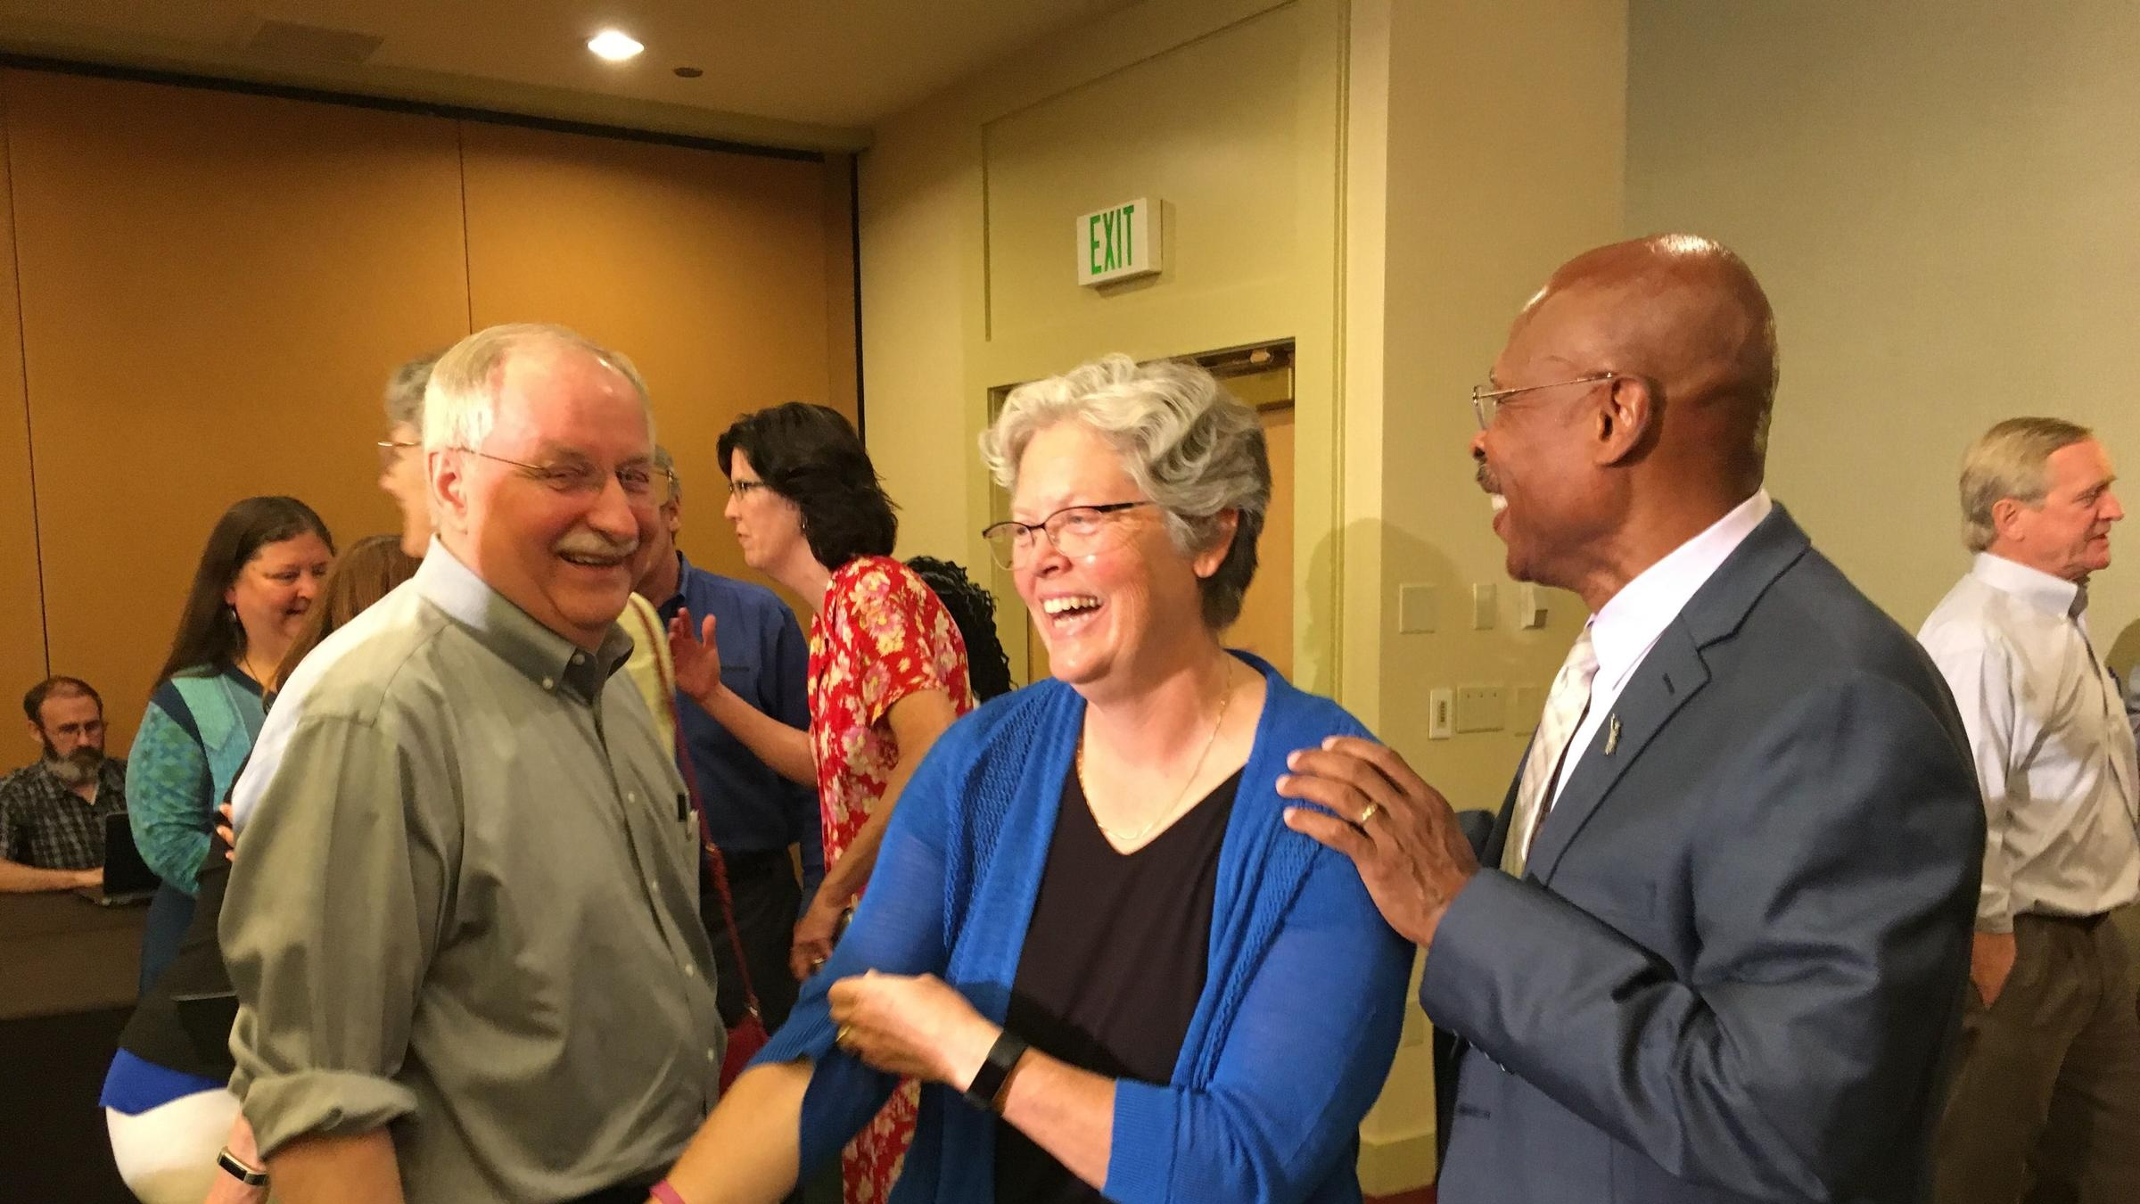
2020-21 Political Landscape
Elections
Budgets
Address response to COVID-19?
Advance Economic Recovery?
Advance Racial Equity?
Address the global Climate crisis?
Notes:
Elections
No gains despite millions outspending Rs.
Outstanding 5th LD: Mark Mullet and Ingrid Andersons. Mullet up 57 votes. Goes to hand recount. Will set TONE in senate
19th flipped to R; 28th flipped to D. Other election night “wins” lost as more ballots came in. Opposite of national trend
Tremendous turnover NEW Members: 21* (returning McCune, Robertson, chamber change Gildon)
County races just as significant
Budgets
Revenue votes for new members will have an impact. 5th and 28th
COVID
LHJ roles and responsibilities, Health-individual and population, telehealth, Housing, Childcare, Education, Wildfires, etc
Economic Recovery- Unemployment, business support, investments in infrastructure
Racial equity- Police reform….
Is it urgent???
Ask yourself NEXT, does this bill:
Advance racial equity?
Address response to the COVID-19 pandemic?
Advance economic recovery?
Address the global climate crisis?

Slide 9
Advocacy Types
Education vs Lobbying
Direct & Grassroots
Education describes your program’s success and would include an overview, goals, budgets, people served, grants/awards. Highlight important policies and funding sources/
Lobbying includes education and influences legislation by communicating a specific position or request a specific action on legislation.
Direct lobbying involves a person telling her views to someone directly involved with developing legislation.
Grassroots lobbying communicates a particular view regarding a specific legislative proposal to the general public and persuades citizens to relay this view to their local legislators.
Notes:
Advocacy is a catch-all term covering many forms of “speaking up.” Community
education, giving testimony at a public hearing, talking about a program or issue
you believe in, joining a lawsuit to force land use reforms are all forms of advocacy.
ADVOCATING: Conveys a value in a general sense. “Clean air is good, and we should protect the environment.”
EDUCATION: Does not make value judgments or seek legislative action. Legislator does not disclose their position.
LOBBYING: Makes a value judgment and does seek specific legislative action. Attempt to get a commitment from legislator.

Slide 10
CDs CAN:
Educate on various issues and their impact.
Meet with a non-legislative group, such as a school board, the state board of health, a chamber of commerce, a civic club, police chief, a trade association, etc.
Host or attend appreciation luncheons, breakfasts, legislative wrap-up sessions and the like.
Sponsor a candidates' forum, as long as you do not endorse a candidate or take a position on an issue to be voted on, such as a referendum or constitutional amendment.
Inform legislators about the results of nonpartisan analysis, study or research.
Inform collaborative members about legislation.
Write a letter that provides general education on an issue, but does not include a call to action on specific legislation.
Answer fully and directly if asked about a specific bill by an elected representative or their staff.
Notes:
SAFELY without facing PDC restrictions

Slide 11
CDs CANNOT:
Participate or intervene in, directly or indirectly, any political campaign on behalf of any candidate for public office. This includes both partisan and non-partisan races.
Support, oppose or endorse, in any way, any candidate who is running for a public office.
Ask a legislator to vote for or against a particular bill.
Ask a collaborative member to contact their legislator and ask them to vote for or against a particular bill.
Send a letter to the Governor and ask them to veto a bill.

Slide 12
Legislative Outreach
Get to know your legislators and other stakeholders-
Seek opportunities outside of Olympia to engage with policy makers (includes LAs) and build coalitions
Know the process- http://leg.wa.gov/legislature/Pages/ComingToTheLegislature.aspx
Be the expert-
Know your audience, know who the issue impacts and their position, the influence on other efforts, share a personal story
Notes:
Outside of Olympia includes attend town halls, share press releases, email news articles, tour projects, invite to ribbon cuttings, invite as conference speakers
Know the process- how a bill becomes law, how to read a bill. Preemption example, understand budget process, watch TVW
Expert. Your personal experience, your story has impact. Make it interesting and distinguish your project or program from the others: unique arrangement? Innovative use of partnerships

Slide 13
COVID considerations:
Finally, avoid…
Does it cost money?
Has it been vetted?
Has this policy been thoroughly vetted with stakeholders?
If it is likely to cost money, have you discussed its viability with the fiscal chair given budget challenges?
Is the other chamber aware and if so, is the bill likely to also advance in the there?
Is it likely to generate substantial opposition in committee and/or on the floor?
Omnibus bills
Companion bills
“intro” bills
Taskforce bills
Save money or increase the efficacy of appropriations within the upcoming biennium?
Help Washington access federal funding?
Help other levels of government do their job to respond to the pandemic or advance economic recovery?
Notes:
Is it urgent?
Policy priorities: COVID Response, economic recovery, racial equity and climate response
AND, does it:
• Save money or increase the efficacy of appropriations within the upcoming biennium?
• Help Washington access federal funding?
• Help other levels of government do their job to respond to the pandemic or advance economic recovery?
Other considerations to help NARROW your list of bills for introduction:
• Has this policy been thoroughly vetted with stakeholders?
• If it is likely to cost money, have you discussed its viability with the Appropriations chair given budget challenges?
• Is the Senate aware and if so, is the bill likely to also advance in the Senate?
• Is it likely to generate substantial opposition in committee and/or on the floor?
For many reasons, please avoid:
• Omnibus bills, unless absolutely necessary – these attract amendments and have a tendency to crush under their own weight;
• Advancing dueling companion bills, unless absolutely necessary – while easy to introduce, moving two vehicles through the process will take time away from other legislation;
• Bills that are not expected to advance this year – interim work sessions are an alternative for creating awareness about your especially ambitious policy idea;
• Taskforce bills – these generate substantial interim work for legislative staff and executive branch agencies, when there may be other, less work-intensive methods to advance, evaluate or build consensus for your policy idea.

Slide 14
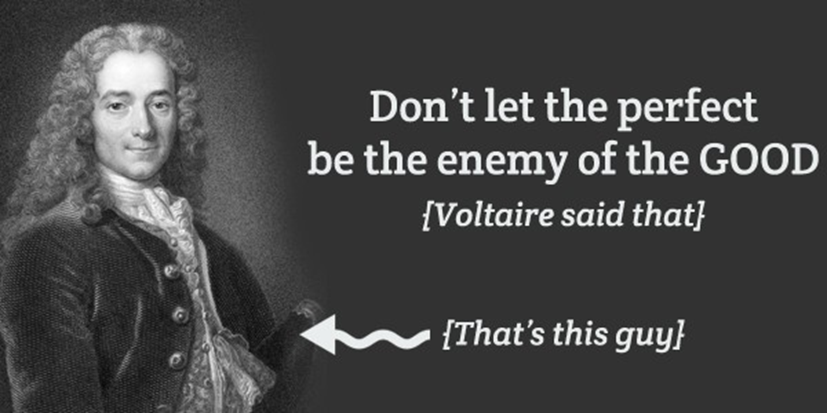
Successful Coalition Strategies
Well defined & limited priorities
Consistent messaging
Personal stories
Community and Environmental benefits
Dollars leveraged/matched
Multiple Benefits (in projects impacts, but also multiple organizations benefit, the economy benefits,
Notes:
Consider yourself a salesperson. You are selling your org’s interest. Your audience is policy makers.
Be credible
Be ready to compromise
If known, share what the opponents arguments are going to be. Then refute them.

Slide 15
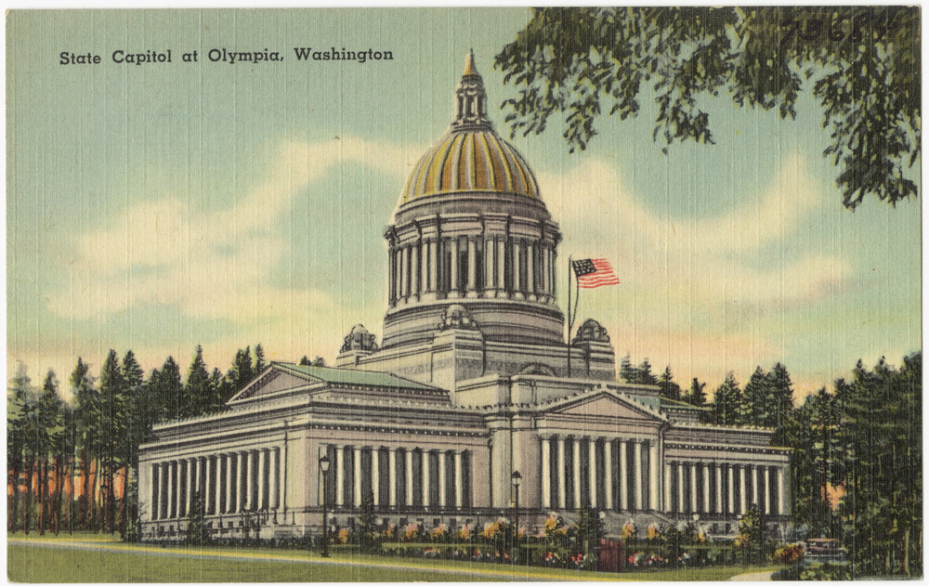

Questions / Discussion

Slide 16

Legislative Policy (Bills)
Proactive vs. Reactive Lawmaking
Where do policy ideas come from?
Lawmakers
State and Local agencies
Events/News stories
Constituent requests
Workgroup recommendations
Lawsuits
Interest groups
Notes:
State agencies develop “decision Packages” which may include policy priorities
Some are pre-filed others have until policy cutoff, after the first few weeks of session.
Orca TF example of workgroup recommendations
Ricki’s law- mix of an event and constituent request. Law allows someone to be involuntarily committed if they are deemed at-risk of harming themselves. 'Ricky's Law' is named after a suicide survivor and former drug addict who is now four years clean and sober. (eventual state Rep. Lauren Davis)
“McCleary decision” and “Culvert case” (fish barrier removal): Lawsuits
Policy Committees and if there is a fiscal impact, must go to fiscal committee as well. Can be passed to Governor throughout session. Governor can veto entire sections (not line items)

